Slide 1
Discrete Mathematics: Lecture 24 Part IV. Graph Theory Matching, path, connected, disconnected, connected component, cut vertex, vertex cut, nonseparable, vertex connectivity, 𝑘-connected, cut edge, edge cut, edge connectivity
Xuming He
Associate Professor
School of Information Science and Technology
ShanghaiTech University
Spring Semester, 2024
Notes by Prof. Liangfeng Zhang

Slide 2
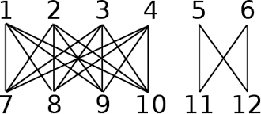
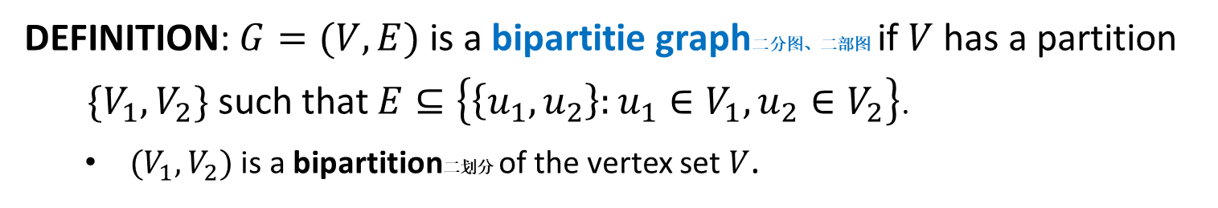
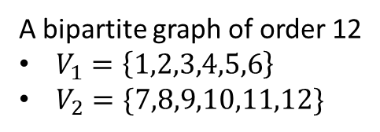
Review: Bipartite Graph
DEFINITION: $G=(V,E)$ is a bipartitie graph二分图、二部图 if $V$ has a partition
$\{V_{1},V_{2}\}$ such that $E⊆\left\{\left\{u_{1},u_{2}\right\}:u_{1}∈V_{1}, u_{2}∈V_{2}\right\}$.
$(V_{1},V_{2})$ is a bipartition二划分 of the vertex set $V$.
A bipartite graph of order 6
A bipartite graph of order 12
$V_{1}=\left\{1,2,3,4,5,6\right\}$
$V_{2}=\{7,8,9,10,11,12\}$

Slide 3

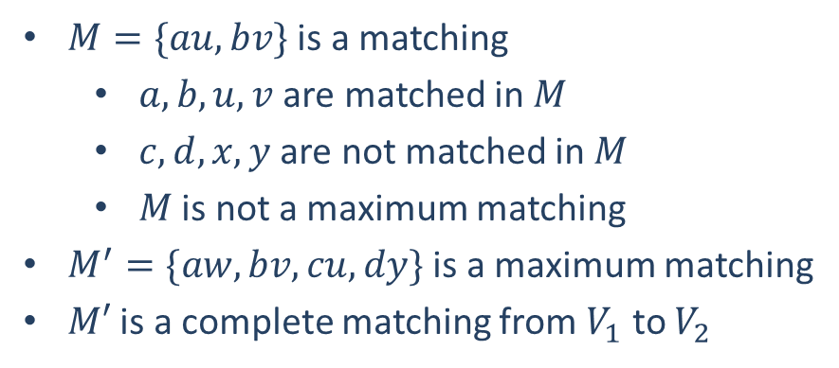
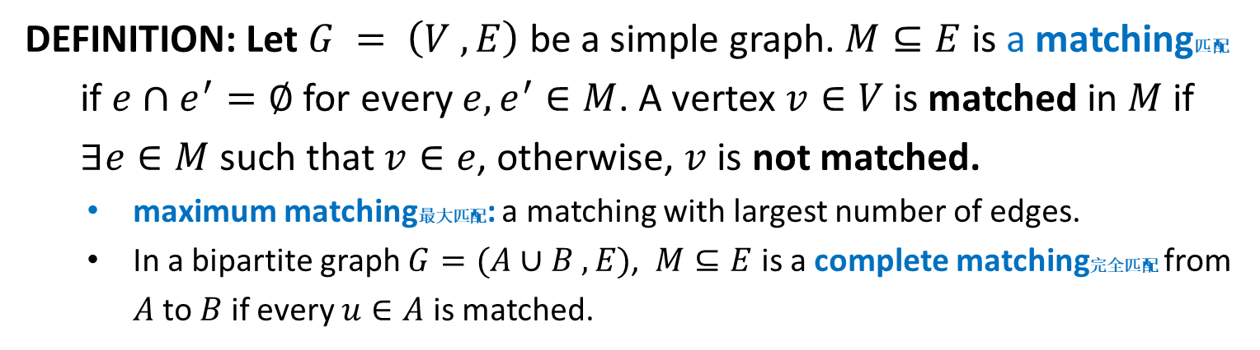








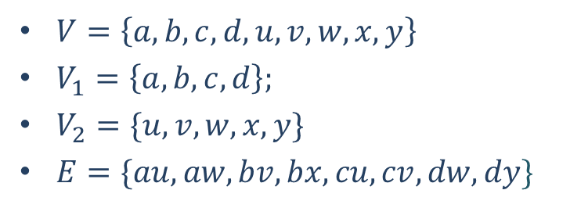
Review: Matching
DEFINITION: Let $G = \left(V ,E\right)$ be a simple graph. $M⊆E$ is a matching匹配
if $e∩e^{′}=∅$ for every $e,e^{′}∈M$. A vertex $v∈V$ is matched in $M$ if
$∃e∈M$ such that $v∈e$, otherwise, $v$ is not matched.
maximum matching最大匹配: a matching with largest number of edges.
In a bipartite graph $G=(A∪B ,E)$, $M⊆E$ is a complete matching完全匹配 from $A$ to $B$ if every $u∈A$ is matched.
$M=\{au, bv\}$ is a matching
$a, b, u, v$ are matched in $M$
$c,d,x,y$ are not matched in $M$
$M$ is not a maximum matching
$M^{′}=\{aw,bv,cu, dy\}$ is a maximum matching
$M′$ is a complete matching from $V_{1}$ to $V_{2}$
$$a$$
$$b$$
$$c$$
$$d$$
$$u$$
$$v$$
$$w$$
$$x$$
$$y$$
$V=\left\{a,b,c,d,u,v,w,x,y\right\}$
$V_{1}=\left\{a,b,c,d\right\};$
$V_{2}=\{u,v,w,x,y\}$
$E=\{au,aw,bv,bx,cu,cv,dw,dy\}$

Slide 4
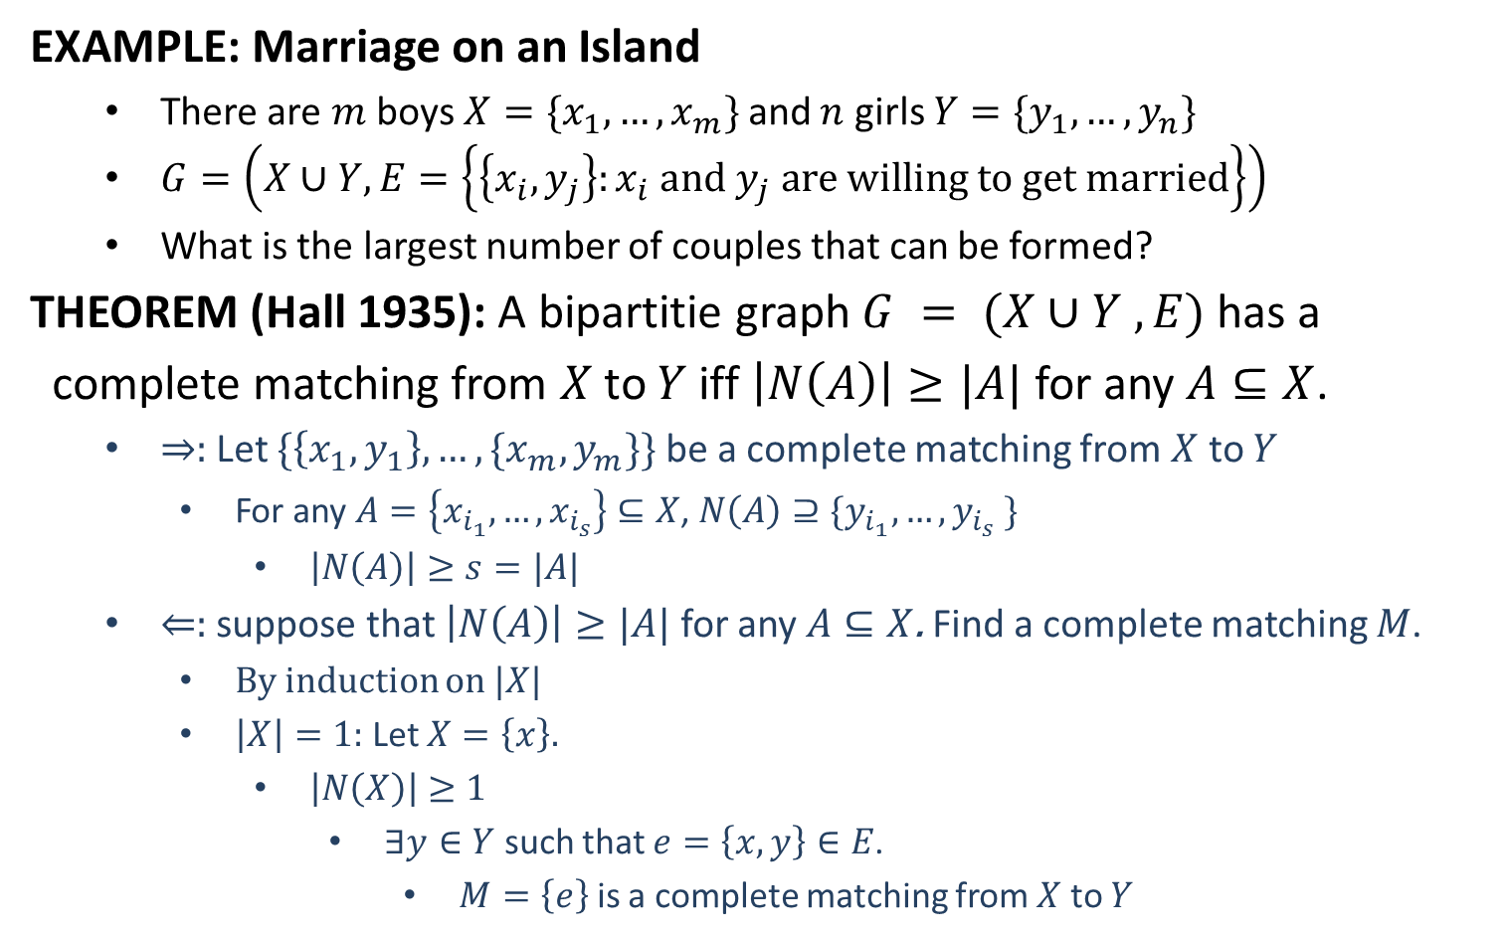
Review: Hall’s Theorem
EXAMPLE: Marriage on an Island
There are $m$ boys ${X=\{x}_{1},…,x_{m}\}$ and $n$ girls $Y=\{y_{1},…,y_{n}\}$
$G=\left(X∪Y, E=\left\{\left\{x_{i},y_{j}\right\}:x_{i} and y_{j} are willing to get married\right\}\right)$
What is the largest number of couples that can be formed?
THEOREM (Hall 1935): A bipartitie graph $G = (X∪Y ,E)$has a
complete matching from $X$to $Y$ iff $\left|N\left(A\right)\right|≥|A|$ for any $A⊆X$.
$⇒:$Let $\{\left\{x_{1},y_{1}\right\},…,\{x_{m},y_{m}\}\}$ be a complete matching from $X$ to $Y$
For any $A=\left\{x_{i_{1}},…,x_{i_{s}}\right\}⊆X$, $N\left(A\right)⊇\{y_{i_{1}},…,y_{i_{s}} \}$
$\left|N\left(A\right)\right|≥s=|A|$
$⇐:$ suppose that $\left|N\left(A\right)\right|≥|A|$ for any $A⊆X$. Find a complete matching $M$.
By induction on $|X|$
$\left|X\right|=1:$ Let $X=\left\{x\right\}.$
$\left|N\left(X\right)\right|≥1$
$∃y∈Y$ such that $e=\left\{x,y\right\}∈E$.
$M=\left\{e\right\}$ is a complete matching from $X$ to $Y$

Slide 5
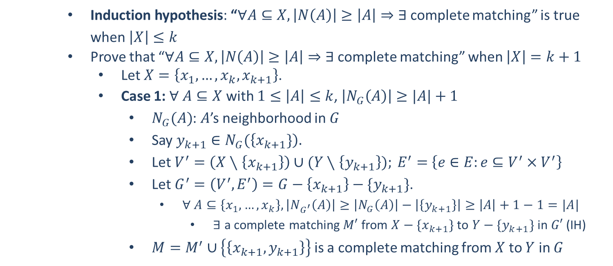
Hall’s Theorem
Induction hypothesis: “$∀A⊆X, \left|N\left(A\right)\right|≥\left|A\right|⇒∃$complete matching” is true when $\left|X\right|≤k$
Prove that “$∀A⊆X, \left|N\left(A\right)\right|≥\left|A\right|⇒∃$complete matching” when $\left|X\right|=k+1$
Let $X=\left\{x_{1},…,x_{k},x_{k+1}\right\}$.
Case 1: $∀ A⊆X$ with $1≤\left|A\right|≤k$, $\left|N_{G}\left(A\right)\right|≥|A|+1$
$N_{G}(A)$: $A$’s neighborhood in $G$
Say $y_{k+1}∈N_{G}(\left\{x_{k+1}\}\right).$
Let $V^{′}=\left(X∖\left\{x_{k+1}\right\}\right)∪(Y∖\left\{y_{k+1}\right\}); E^{′}=$ $\left\{e∈E:e⊆V^{′}×V^{′}\right\}$
Let $G^{′}=\left(V^{′},E^{′}\right)=G−\left\{x_{k+1}\right\}−\{y_{k+1}\}$.
$∀ A⊆\left\{x_{1},…,x_{k}\right\}, \left|N_{G^{′}}\left(A\right)\right|≥\left|N_{G}\left(A\right)\right|−\left|\left\{y_{k+1}\right\}\right|≥\left|A\right|+1−1=|A|$
$∃$ a complete matching $M′$ from $X−\{x_{k+1}\}$ to $Y−\{y_{k+1}\}$ in $G′$ (IH)
$M=M^{′}∪\left\{\left\{x_{k+1}, y_{k+1}\right\}\right\}$ is a complete matching from $X$ to $Y$ in $G$

Slide 6
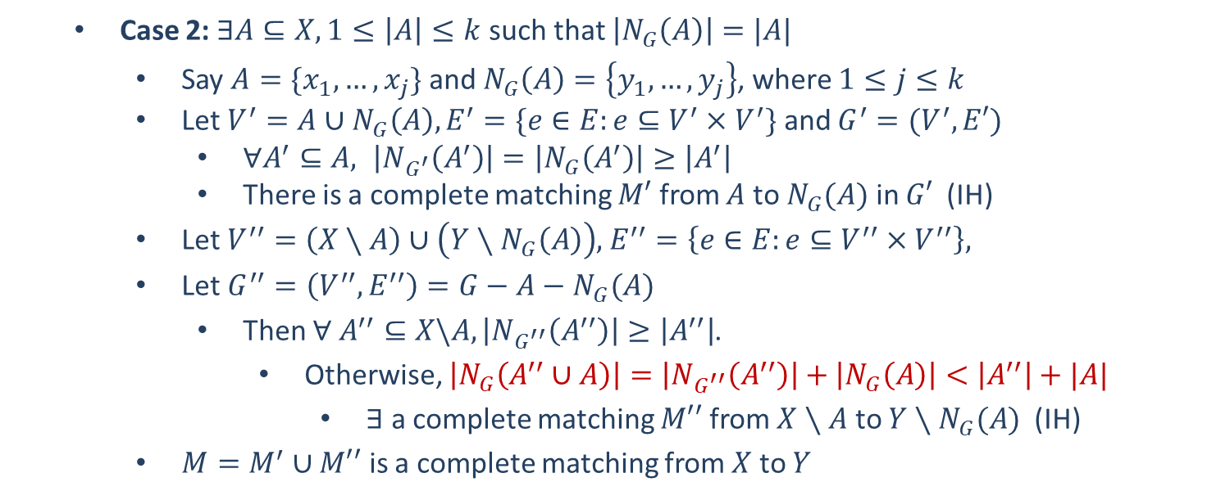
Hall’s Theorem
Case 2: $∃A⊆X, 1≤\left|A\right|≤k$ such that $\left|N_{G}\left(A\right)\right|=|A|$
Say $A=\{x_{1},…,x_{j}\}$ and $N_{G}\left(A\right)=\left\{y_{1},…,y_{j}\right\}$, where $1≤j≤k$
Let $V^{′}=A∪N_{G}\left(A\right), E^{′}=\{e∈E:e⊆V^{′}×V^{′}\}$ and $G^{′}=(V^{′},E′)$
$∀A^{′}⊆A, \left|N_{G^{′}}\left(A^{′}\right)\right|=\left|N_{G}\left(A^{′}\right)\right|≥\left|A^{′}\right|$
There is a complete matching $M′$ from $A$ to $N_{G}(A)$ in $G′$ (IH)
Let $V^{′′}=\left(X∖A\right)∪\left(Y∖N_{G}\left(A\right)\right)$, $E^{′′}=\left\{e∈E:e⊆V^{′′}{×V}^{′′}\right\},$
Let $G^{′′}=\left(V^{′′},E^{′′}\right)=G−A−N_{G}(A)$
Then $∀ A^{′′}⊆X\backslash A, \left|N_{G^{′′}}\left(A^{′′}\right)\right|≥\left|A^{′′}\right|$.
Otherwise, $\left|N_{G}\left(A^{′′}∪A\right)\right|=\left|N_{G^{′′}}\left(A^{′′}\right)\right|+\left|N_{G}\left(A\right)\right|<\left|A^{′′}\right|+|A|$
$∃$ a complete matching $M′′$ from $X∖A$ to $Y∖N_{G}(A)$ (IH)
$M=M^{′}∪M′′$ is a complete matching from $X$ to $Y$

Slide 7
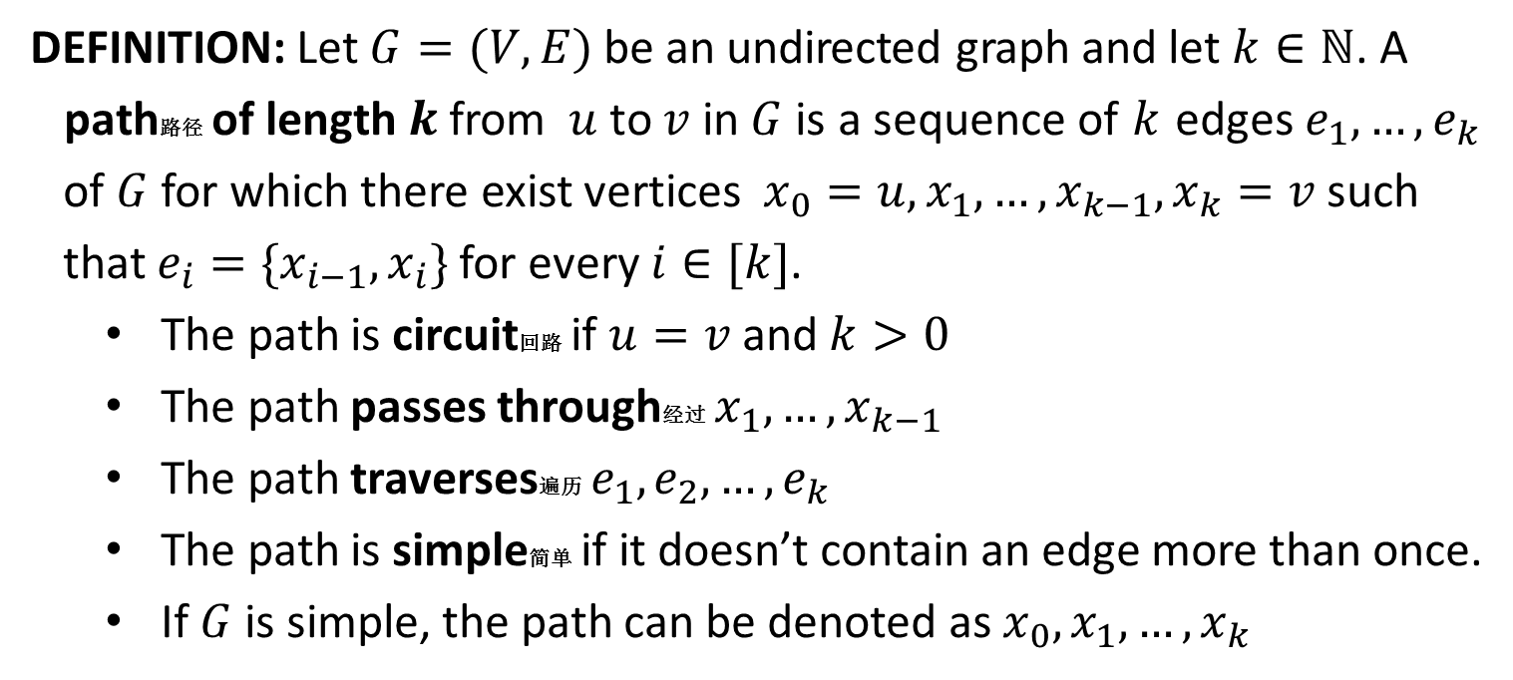
Path (Undirected)
DEFINITION: Let $G=(V,E)$ be an undirected graph and let $k∈ℕ$. A
path路径 of length$k$from $u$ to $v$ in $G$ is a sequence of $k$ edges $e_{1},…,e_{k}$
of $G$ for which there exist vertices $x_{0}=u, x_{1},…,x_{k−1},x_{k}=v$ such
that $e_{i}=\{x_{i−1},x_{i}\}$ for every $i∈[k]$.
The path is circuit回路 if $u=v$ and $k>0$
The path passes through经过 $x_{1},…,x_{k−1}$
The path traverses遍历 $e_{1},e_{2},…,e_{k}$
The path is simple简单 if it doesn’t contain an edge more than once.
If $G$ is simple, the path can be denoted as $x_{0},x_{1},…,x_{k}$

Slide 8
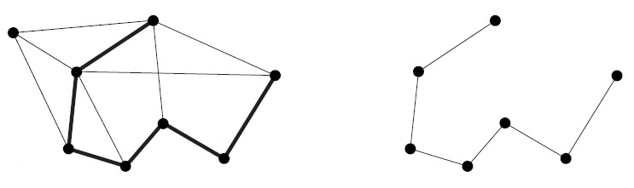
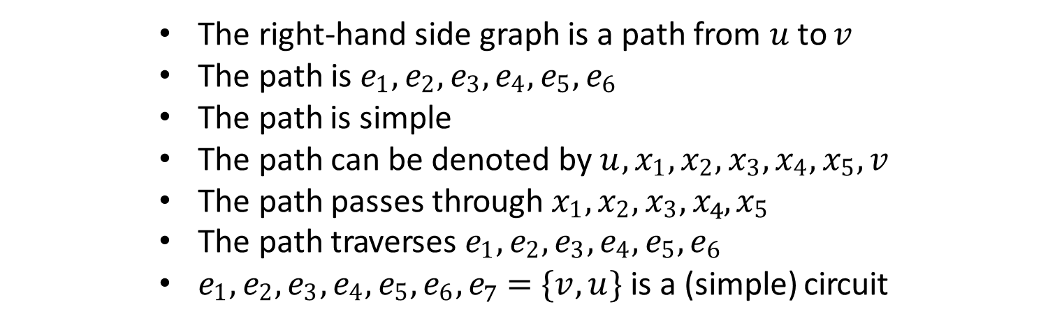
Example
𝑢
𝑢
𝑥₁
𝑒₁
𝑣
𝑥₁
𝑒₁
𝑣
𝑒₂
𝑒₆
𝑒₂
𝑒₆
𝑒
𝑥₄
𝑒₅
𝑒
4 𝑥₄
𝑒₅
𝑒₃
4
𝑒₃
𝑥₂
𝑥₅
𝑥₂
𝑥₅
𝑥
3
𝑥
3
The right-hand side graph is a path from 𝑢 to 𝑣
The path is $e1, e2, e3, e4, e5, e6$
The path is simple
The path can be denoted by $u, x1, x2, x3, x4, x5, v$
The path passes through $x1, x2, x3, x_{4}, x5$
The path traverses $e1, e2, e3, e4, e5, e6$
$e1, e2, e3, e4, e5, e6, e_{7}=\{v, u\}$is a (simple) circuit

Slide 9
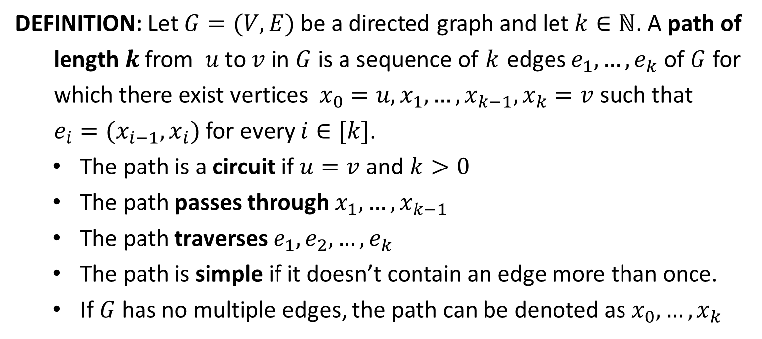
Path (Directed)
DEFINITION: Let $G=(V,E)$ be a directed graph and let $k∈ℕ$. A path of
length$k$from $u$ to $v$ in $G$ is a sequence of $k$ edges $e_{1},…,e_{k}$ of $G$ for
which there exist vertices $x_{0}=u, x_{1},…,x_{k−1},x_{k}=v$ such that
$e_{i}=(x_{i−1},x_{i})$ for every $i∈[k]$.
The path is a circuit if $u=v$ and $k>0$
The path passes through $x_{1},…,x_{k−1}$
The path traverses $e_{1},e_{2},…,e_{k}$
The path is simple if it doesn’t contain an edge more than once.
If $G$ has no multiple edges, the path can be denoted as $x_{0}, …,x_{k}$

Slide 10
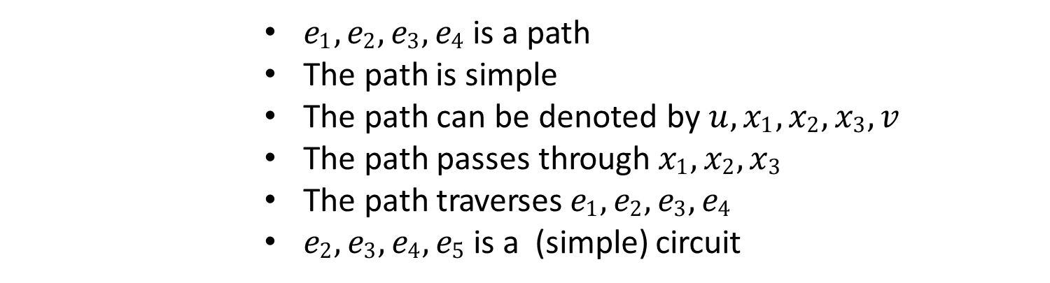
Example
𝑥₂
𝑥₂
𝑥₃
𝑒₃
𝑒₂
𝑥₁
𝑥₃
𝑒
𝑒₂
𝑥₁
3
𝑒₄
𝑒₁
𝑢
𝑒₄
𝑒₁
𝑢
𝑒
5
𝑣
𝑣
$e1, e2, e3, e4$is a path
The path is simple
The path can be denoted by $u, x1, x2, x3, v$
The path passes through $x1, x2, x3$
The path traverses $e1, e2, e3, e4$
$e2, e3, e4, e5$is a (simple) circuit

Slide 11
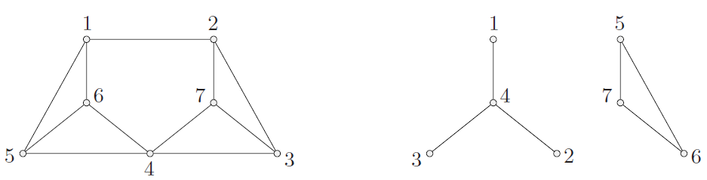
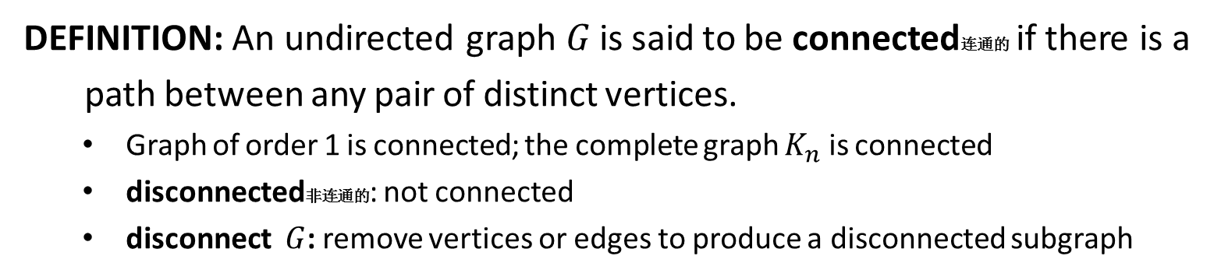
Connectivity
DEFINITION: An undirected graph 𝐺 is said to be connected连通的 if there is a
path between any pair of distinct vertices.
Graph of order 1 is connected; the complete graph $K_{n}$ is connected
disconnected非连通的: not connected
disconnect $G$: remove vertices or edges to produce a disconnected subgraph
A Connected Graph
A Disconnected Graph

Slide 12
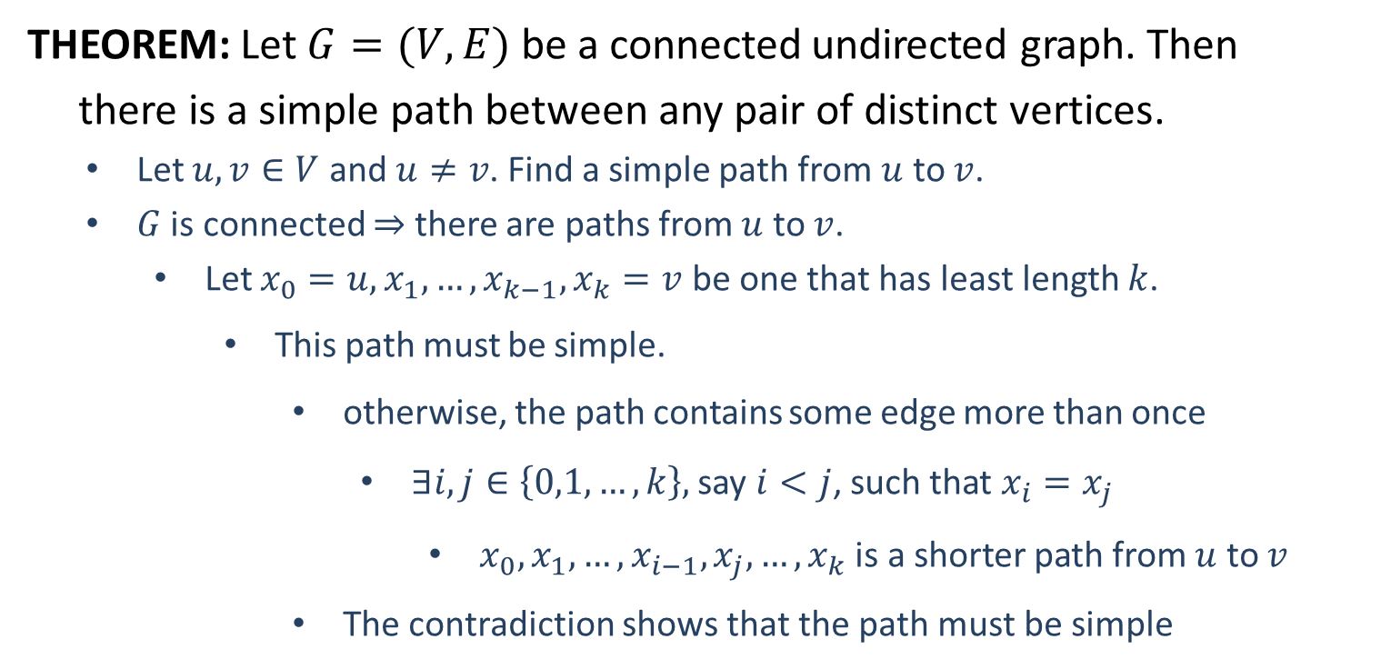
Connectivity
THEOREM: Let 𝐺 = (𝑉, 𝐸) be a connected undirected graph. Then
there is a simple path between any pair of distinct vertices.
Let $u,v∈V$ and $u≠v$. Find a simple path from $u$ to $v$.
$G$ is connected $⇒$ there are paths from $u$ to $v$.
Let $x_{0}=u, x_{1},…,x_{k−1},x_{k}=v$ be one that has least length $k$.
This path must be simple.
otherwise, the path contains some edge more than once
$∃i,j∈\left\{0,1,…,k\right\},$ say $i<j$, such that $x_{i}=x_{j}$
$x_{0},x_{1},…,x_{i−1},x_{j}, …, x_{k}$ is a shorter path from $u$ to $v$
The contradiction shows that the path must be simple

Slide 13
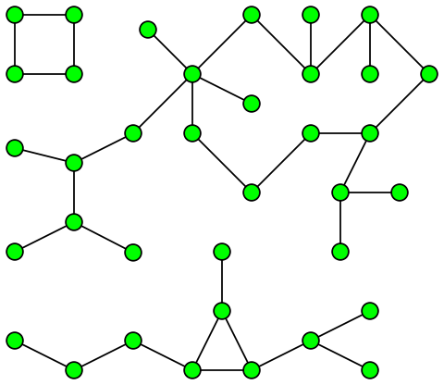
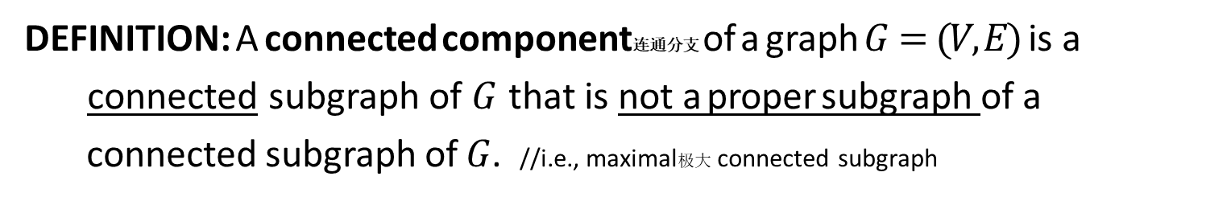
Connected Component
DEFINITION: A connected component连通分支 of a graph $G=(V,E)$ is a
connected subgraph of $G$ that is not a proper subgraph of a
connected subgraph of 𝐺. //i.e., maximal极大 connected subgraph

Slide 14
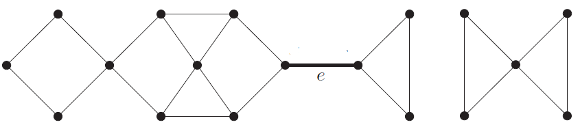

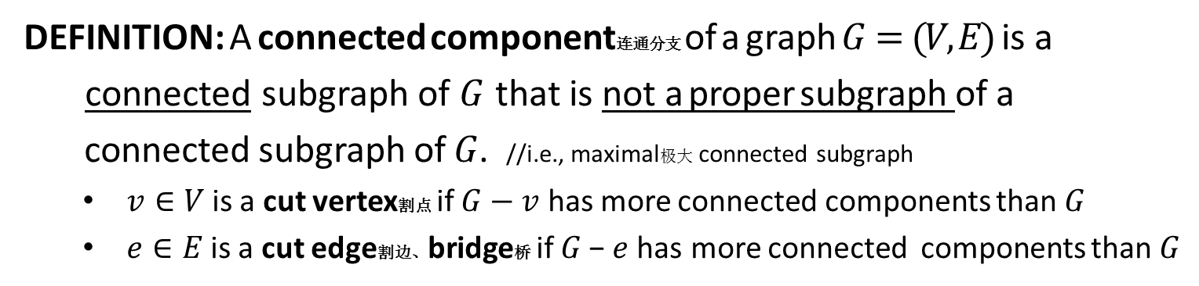

Connected Component
DEFINITION: A connected component连通分支 of a graph $G=(V,E)$ is a
connected subgraph of $G$ that is not a proper subgraph of a
connected subgraph of 𝐺. //i.e., maximal极大 connected subgraph
$v∈V$ is a cut vertex割点 if $G−v$ has more connected components than $G$
$e∈E$ is a cut edge割边、bridge桥 if 𝐺 − 𝑒 has more connected components than $G$
𝑢
𝑣
𝑤
𝑥
$$G$$
There are 2 connected components in the graph $G$
cut vertices: 𝑢, 𝑣, 𝑤, 𝑥
cut edge: 𝑒

Slide 15

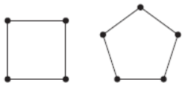
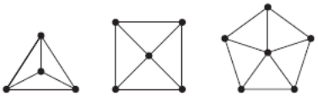
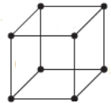
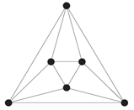





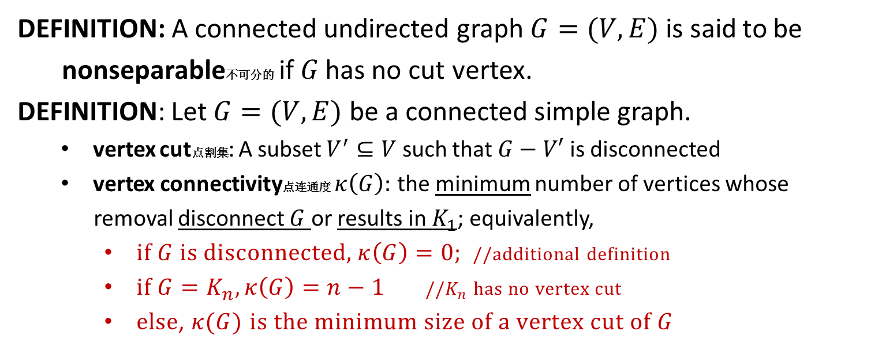







Vertex Connectivity
DEFINITION: A connected undirected graph 𝐺 = (𝑉, 𝐸) is said to be
nonseparable不可分的 if 𝐺 has no cut vertex.
DEFINITION: Let $G=(V,E)$ be a connected simple graph.
vertex cut点割集: A subset $V^{′}⊆V$ such that $G−V′$ is disconnected
vertex connectivity点连通度 $κ\left(G\right):$ the minimum number of vertices whose
removal disconnect $G$ or results in $K_{1}$; equivalently,
if $G$ is disconnected, $κ\left(G\right)=0;$ //additional definition
if $G=K_{n}, κ\left(G\right)=n−1$ //$K_{n}$ has no vertex cut
else, $κ(G)$ $is the minimum size of a vertex cut of G$
$$0$$
$$1$$
$$2$$
$$3$$
$$4$$
$$2$$
$$2$$
$$3$$
$$3$$
$$3$$
$$3$$
$$4$$
These graphs are all nonseparable

Slide 16
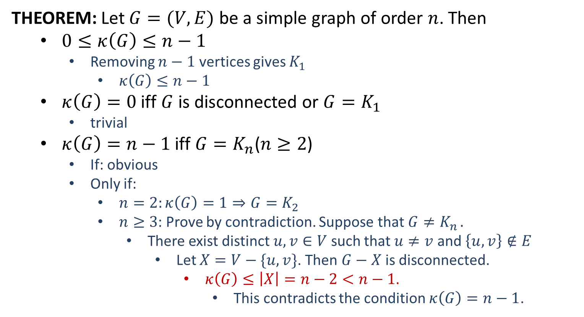
Vertex Connectivity
THEOREM: Let $G=(V,E)$ be a simple graph of order $n$. Then
$0≤κ\left(G\right)≤n−1$
Removing $n−1$ vertices gives $K_{1}$
$κ\left(G\right)≤n−1$
$κ\left(G\right)=0$ iff $G$ is disconnected or $G=K_{1}$
trivial
$κ\left(G\right)=n−1$ iff $G=K_{n}$($n≥2$)
If: obvious
Only if:
$n=2:κ\left(G\right)=1⇒G=K_{2}$
$n≥3$: Prove by contradiction. Suppose that $G≠K_{n}$.
There exist distinct $u,v∈V$ such that $u≠v$ and $\left\{u,v\right\}∉E$
Let $X=V−\{u,v\}$. Then $G−X$ is disconnected.
$κ\left(G\right)≤\left|X\right|=n−2<n−1$.
This contradicts the condition $κ\left(G\right)=n−1$.

Slide 17
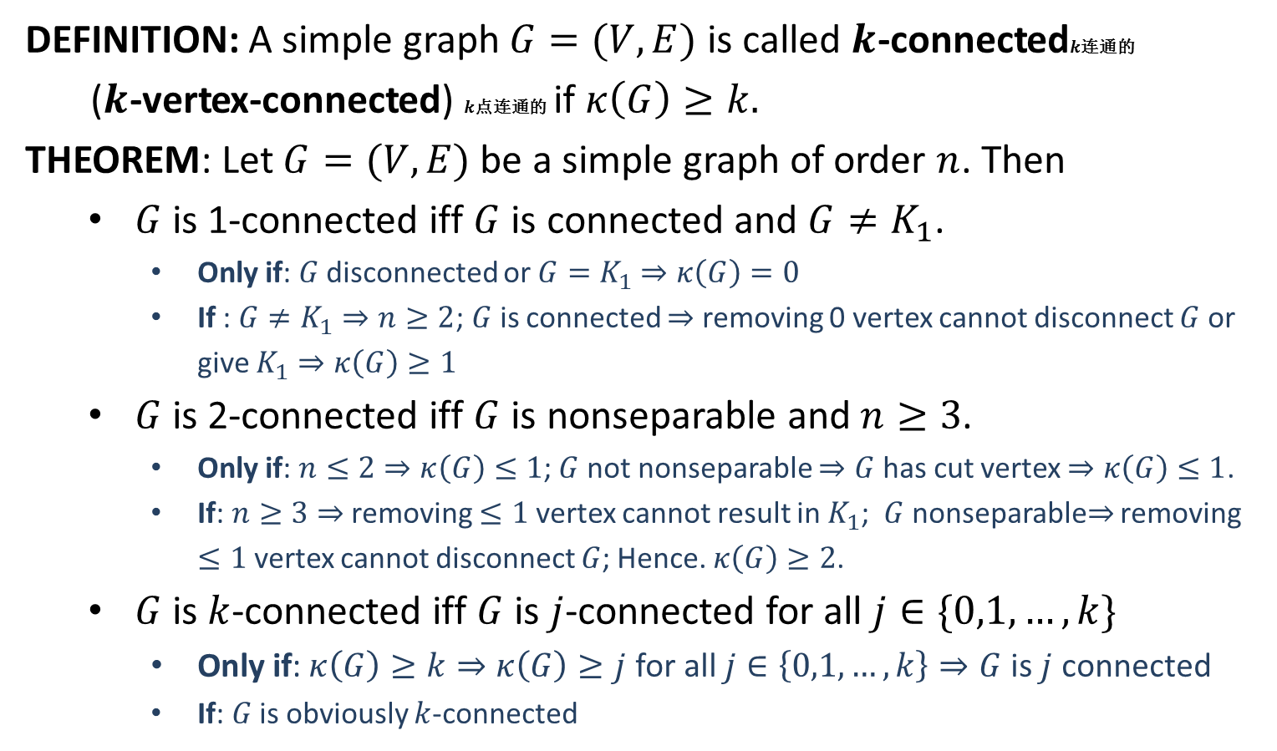
Vertex Connectivity
DEFINITION: A simple graph $G=(V,E)$ is called $k$-connected$k$连通的
($k$-vertex-connected) $k$点连通的 if $κ\left(G\right)≥k.$
THEOREM: Let $G=(V,E)$ be a simple graph of order $n$. Then
$G$ is 1-connected iff $G$ is connected and $G≠K_{1}$.
Only if: $G$ disconnected or $G=K_{1}$ $⇒κ\left(G\right)=0$
If : $G≠K_{1}⇒n≥2$; $G$ is connected $⇒$ removing 0 vertex cannot disconnect $G$ or give $K_{1}⇒κ\left(G\right)≥1$
$G$ is 2-connected iff $G$ is nonseparable and $n≥3$.
Only if: $n≤2⇒κ\left(G\right)≤1$; $G$ not nonseparable $⇒G$ has cut vertex $⇒κ\left(G\right)≤1$.
If: $n≥3⇒$ removing $≤1$ vertex cannot result in $K_{1}$; $G$ nonseparable$⇒$ removing $≤1$ vertex cannot disconnect $G$; Hence. $κ\left(G\right)≥2$.
$G$ is $k$-connected iff $G$ is $j$-connected for all $j∈\{0,1,…,k\}$
Only if:$κ\left(G\right)≥k⇒κ\left(G\right)≥j$ for all $j∈\left\{0,1,…,k\right\}⇒G$ is $j$ connected
If: $G$ is obviously $k$-connected

Slide 18





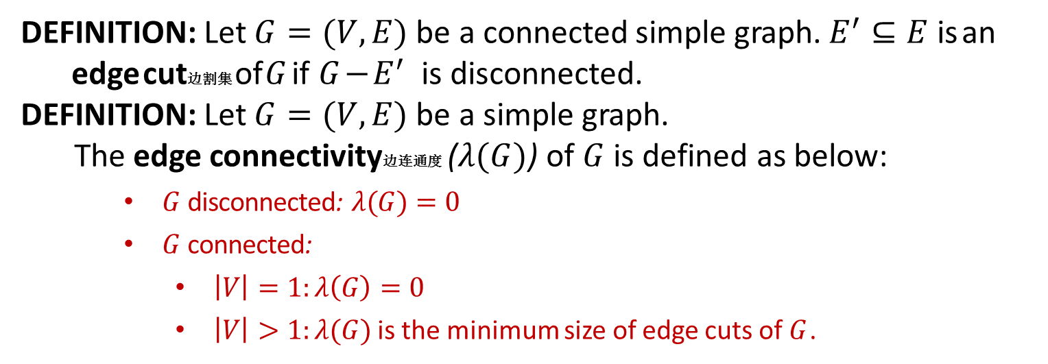







Edge Connectivity
DEFINITION: Let $G=(V,E)$ be a connected simple graph. $E^{′}⊆E$ is an
edge cut边割集 of $G$ if $G−E^{′}$ is disconnected.
DEFINITION: Let $G=(V,E)$ be a simple graph.
The edge connectivity边连通度 ($λ(G)$) of $G$ is defined as below:
$G$ disconnected: $λ(G)=0$
$G$ connected:
$\left|V\right|=1:λ\left(G\right)=0$
$\left|V\right|>1:λ(G)$ is the minimum size of edge cuts of $G$.
$$0$$
$$1$$
$$2$$
$$3$$
$$4$$
$$2$$
$$2$$
$$3$$
$$3$$
$$3$$
$$3$$
$$4$$

